Slide 1
Java Array
The array, which stores a fixed-size sequential collection of elements of the same type.
An array is used to store a collection of data, but it is often more useful to think of an array as a collection of variables of the same type.

Slide 2
Declaring Array Variables
Here is the syntax for declaring an array variable −
Syntax
dataType[] arrayRefVar;
dataType arrayRefVar[];

Slide 3
Example The following code snippets are examples of this syntax − double[] myList; or double myList[];

Slide 4
Creating Arrays
You can create an array by using the new operator with the following syntax −
arrayRefVar = new dataType[arraySize];
It creates an array using new dataType[arraySize].
It assigns the reference of the newly created array to the variable arrayRefVar.
Declaring an array variable, creating an array, and assigning the reference of the array to the variable can be combined in one statement, as shown below:
dataType[] arrayRefVar = new dataType[arraySize];

Slide 5
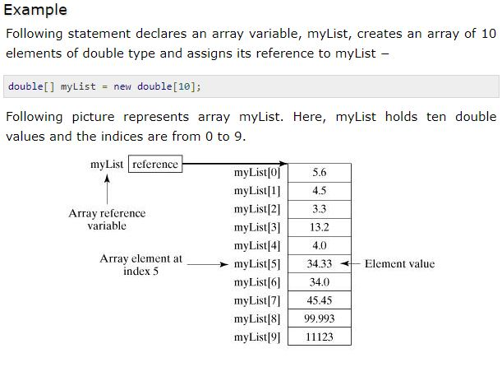

Slide 6
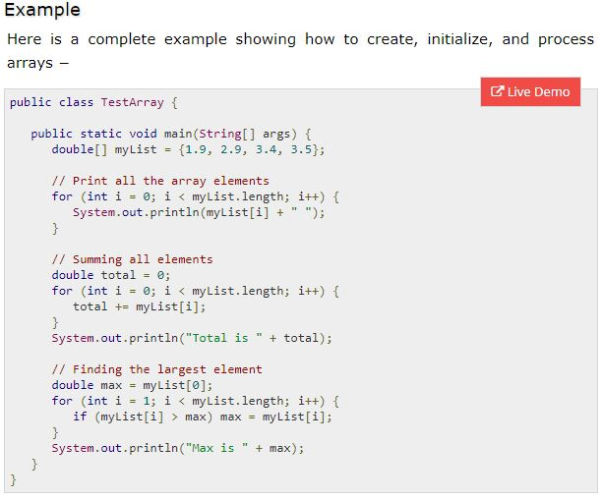

Slide 7
